Slide 1

Cosine Similarity
Gaurav Ojha

Slide 2
Here are some sentences
I love Troll2!
I like Troll 2.
I love Troll 2! I love it!!!
Troll 2 is bad.
Notes:
By eye, it’s pretty easy to see that the first 3sentences are similar to each other – they all express a positive feeling towards the movie.
In contrast, this last sentence is from someone who does not like the movie.

Slide 3
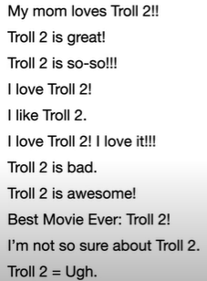
Similar or Not
When we don’t have many sentences, it’s pretty easy to see which ones are similar to each other and which ones are not.
However, what would we do if we collected all of the Twitter traffic for the last month. How would we determine similarities and differences in the tweets?
In this case, we can no longer rely on doing things by eye , and instead have to get a computer to do it.
This is where cosine similarity comes in

Slide 4
Cosine Similarity
The Cosine Similarity is a relatively easy to calculate metric that can tell us how similar or different things are.

Slide 5
Intuition Behind Cosine Similarity
Let’s start with a super simple example:
Hello, World!
Hello!
Question: Here we want to know how similar the phrase “Hello, World!” is to “Hello!”

Slide 6
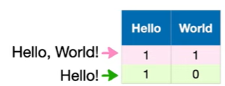
Step 1: Make a table
First thing that we do is make a table for the words that appear in the phrases: Hello and World
Now given this table of counts for each word in each phrase, we create a 2-dimensional graph that has the number of times we saw the word Hello on the x-axis and the number of times we saw the word World on the Y-axis

Slide 7
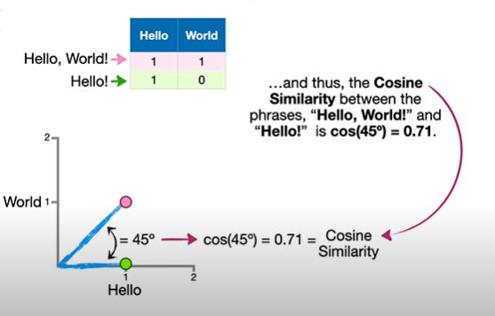
Step 2: Plot the graph
Notes:
Plot the point over a graph. And raw lines to these points from the origin (0,00

Slide 8

What if the 2nd word changes?

Slide 9
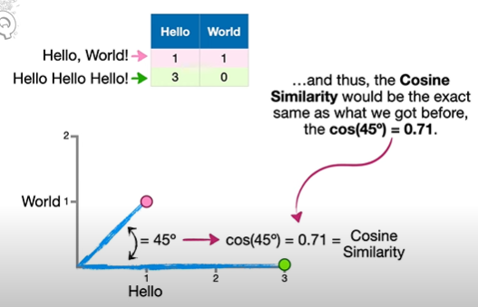
Cosine Similarity Stays The Same!

Slide 10
So what is Cosine Similarity?
Cosine similarity is determined entirely by the angle between the lines and not by the length of the lines.

Slide 11
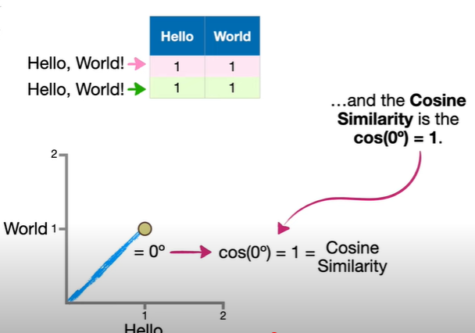
What if we have the same words?

Slide 12
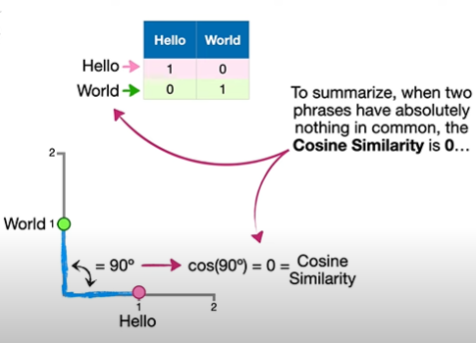
No words in common?

Slide 13
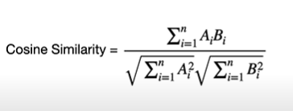
Eq for Cosine Similarity
i=index; n= number of different words in the phrases; A & B : Refer to the 2 phrases

Slide 14
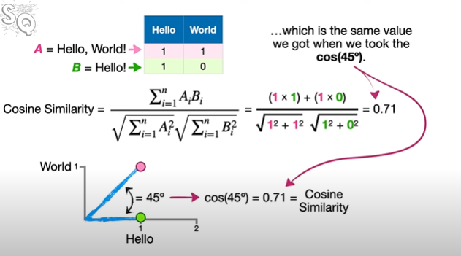
Calculating Previous Example Using The Equation

Slide 15
Question
Calculate the Cosine Similarity for these 2 phrases:
1. I love Troll 2! (A)
2. I love Gymkata! (B)

Slide 16
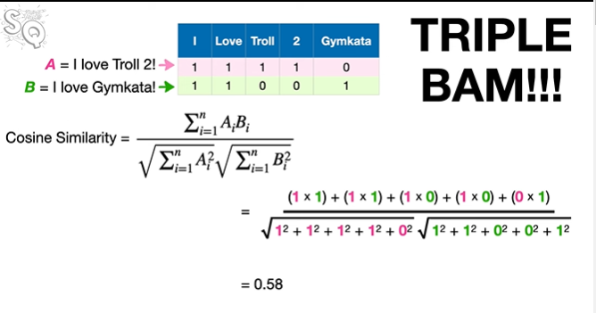
Solution

